Slide 1
بسم الله الرحمن الرحيم
اسئلة واجابات امتحان متطلبات هندسة البرمجيات

Slide 2
السؤال 1
Which one of the following is not a step of requirement engineering?
Answer
design
➔

Slide 3
السؤال 2
System requirements should be concerned with how the system should be designed or implemented.
Answer
False
P 52
➔

Slide 4
السؤال 3
During ---------- process, errors in the requirements document are inevitably discovered
Answer
Requirements validation
➔

Slide 5
السؤال 4
Requirements should specify 'what' but not 'how’.
Answer
True
➔

Slide 6
السؤال 5
----------are derived from the application runs the software system.
Answer
Functional requirements

Slide 7
السؤال 6
Requirements are always ---------------
Answer
Describe detailed properties that the system must have.

Slide 8
السؤال 7
levels of requirements are
Answer
functional requirement, nonfunctional requirements, and product requirement

Slide 9
السؤال 8
The true order of requirements engineering process is:
Answer
Feasibility study, Requirements elicitation and validation, Requirements specification, and Requirements analysis

Slide 10
السؤال 9
Use-case actors are always people, never system devices
Answer
False

Slide 11
السؤال 10
During ------------process, errors in the requirements document are inevitably discovered
Answer
Requirements validation

Slide 12
السؤال 11
User requirements are expanded versions of the system requirements that are used by software engineers as the starting point for the system design.
Answer
False

Slide 13
السؤال 12
-------------are high level statements, written in a natural language, of what services the system is expected to provide, and the constraints under which it must operate.
Answer
System requirements
P 4

Slide 14
السؤال 13
Consider the following description of requirements for the MHC-PMS system, which is used to maintain information about patients receiving treatment for mental health problems
LA user shall be able to search the appointments lists for all clinics
2. The system shall generate each day, for each clinic, a list of patients who are expected to attend appointments that day.
3. Each staff member using the system shall be uniquely identified by his or her eight-digit employee number
These requirements come in form of
Answer
Functional user requirements
P 15

Slide 15
السؤال 14
System requirements should be concerned with how the system should be designed or implemented.
Answer
False
P 4

Slide 16
السؤال 15
Viewpoints are a way of structuring the requirements to represent the perspectives of different stakeholders
Answer
True

Slide 17
السؤال 16
Scenarios are real-life examples of how a system can be used.
Answer
True

Slide 18
السؤال 17
Which one of the following is a functional requirement?
Answer
None of the mentioned
P 4

Slide 19
السؤال 18
Stakeholders who do not use the system themselves but who influence the requirements, This type of viewpoint collect ➔ indirect viewpoints
People or other systems that interact directly with the system, This type of viewpoint collect ➔ interactor viewpoints

Slide 20
السؤال 19
Number of RAM chips ➔ size
Rate of failure occurrence ➔ Reliability
Training time ➔ Ease of use
Number of help frames ➔ Ease of use
Mean time to failure ➔ Reliability
Screen refresh time ➔ Speed
Number of target systems ➔ Portability
Processed transactions/second ➔ Speed
P 29

Slide 21
السؤال 20
show the object classes in the system and the associations between these classes ➔ class diagram
Show the interactions between a system and its environment ➔ use case
show how the system reacts to internal and external events ➔ state diagram
show interactions between actors and the system and between system components ➔ sequence diagram

Slide 22
السؤال 21
Ethnography is effective for understanding existing processes but cannot identify new features that should be added to a system
Answer
False
P 167

Slide 23
السؤال 22
Interviews are good for understanding domain requirements
Answer
True

Slide 24
السؤال 23
The UML sequence diagram show the order in which system events are processed
Answer
True

Slide 25
السؤال 24
Can the requirements be checked ➔ Variability
Are all functions required by the customer included ➔ Completeness
Are there any requirements conflicts ➔ Consistency
Can the requirements be implemented given available budget and technology ➔ Realism
P 37

Slide 26
السؤال 25
Requirements prioritization and negotiation is a solution for the problem of:
Answer
Conflicting among requirements

Slide 27
السؤال 26
Structured natural language ➔ The requirements are written in natural language on a standard form or template
Natural language sentences ➔ The requirements are written using numbered sentences in natural language. Each sentence should
Graphical notations ➔ supplemented by text annotations like UML use case and sequence diagrams are commonly used
Mathematical specifications ➔ Notations such as finite-state machines
P54

Slide 28
السؤال 27
Conflicting requirements are common in Requirement Engineering, with each client proposing his or her version is the right one.
Answer
True

Slide 29
السؤال 28
Structured natural language ➔ The requirements are written in natural language on a standard form or template
Natural language sentences ➔ The requirements are written using numbered sentences in natural language. Each sentence should
Graphical notations ➔ supplemented by text annotations like UML use case and sequence diagrams are commonly used
Mathematical specifications ➔ Notations are based on mathematical concepts and are not reluctant to accept it as a system cont
P54

Slide 30
السؤال 29
When multiple stakeholders are involved, requirements will conflict, which is solved by.
Answer
Requirements prioritization and negotiation

Slide 31
السؤال 30
When there are a number of possible alternative situations and you need to describe the actions to be taken for each of these, the best technique is the using of:
Answer
Tabular specification

Slide 32
السؤال 31
A model aims to represent:
Answer
An abstraction of the system being studied

Slide 33
السؤال 32
-------------requirements are broad system requirements derived from policies and procedures in the customer's and developer's work place.
Answer
Organizational requirements

Slide 34
السؤال 33
Requirements validation techniques includes:
Answer
All of the above.(Prototyping , Requirements reviews, Test-case generation)
P 38

Slide 35
السؤال 34
The translating of the information gathered previously into a document that defines a set of requirements is achaived during:
Answer
Requirements specification
P63

Slide 36
السؤال 35
Actros ➔ those who interact with the system
Use case diagrams ➔ define the main requirements for the system
Associations ➔ indicates how an actor interacts w / a use case

Slide 37
السؤال 36
------------represents the interaction between objects, or between actors and objects.
Answer
Sequence diagram

Slide 38
السؤال 37
Assessing if the system is useful to the business, is the aim of
Answer
feasibility study

Slide 39
السؤال 38
Performance ➔ Product Requirements
P 86
Legislative Requirements ➔ External Requirements
P 21
Development Requirements ➔ Organizational Requirements
Ethical requirements ➔ External Requirements

Slide 40
السؤال 39
A stakeholder is anyone who will purchase the completed software system under development.
Answer
False.

Slide 41
السؤال 40
the requirements specify or constrain the behavior of the software.
Answer
Product requirements
P 21

Slide 42
السؤال 41
-------------are Constraints on the services or functions offered by the system.
Answer
Non-functional requirements
P 4

Slide 43
السؤال 42
An actor in a use-case model can represent one or more of the following
Answer
A dedicated device
An object within the system
An external system
A system user
An internal subsystem

Slide 44
السؤال 43
The <<extend>> relationship between use cases would be used when behavior in the extending use case is the extended use case.
Answer
sometimes needed by

Slide 45
السؤال 44
Payment ➔ Boundary Class
Google Maps API ➔ Boundary Class
Postcode Validator ➔ Control Class
Student Record ➔ Entity Class
Payment Information ➔ Entity Class
Registration Form ➔ Boundary Class

Slide 46
السؤال 45
In Requirements analysis we look for Needs rather than requests
Answer
True
P 157

Slide 47
السؤال 46
Abstract way of functional requirements description is:
Answer
No such form

Slide 48
السؤال 47
Select possible chapters of IEEE standard for requirements documents
Answer
Contents
Abbreviations
Glossary
References
Preface
Introduction

Slide 49
السؤال 48
Document analysis provides clues about existing "as-is" system
Answer
True
P 115

Slide 50
السؤال 49
The benefits of using structured specifications are:
Answer
clarify the requirements
reduced the variability in the specification
requirements are organized more effectively.

Slide 51
السؤال 50
Functional requirements depend on:
Answer
The complexity of the system
The type of software being developed
The expected users of the software

Slide 52
السؤال 51
JAD ➔ As-Is, Improve, To-Be
Document Analysis ➔ As-Is
Interviews ➔As-Is, Improve, To-Be
Observation ➔ As-Is
Prototyping ➔ Improve, To-Be
Questionnaires ➔ As-Is, Improve
P 118

Slide 53
السؤال 52
Extend and include relationships are used for reducing complexity in the use case model
Answer
True

Slide 54
السؤال 53
The roles of the flow of events of the textual representation of a use-case (use-case description) are:
Answer
can be translated into an activity diagram

Slide 55
السؤال 54
Used to show that a certain system service requires executing another service ➔
Used to show that a certain system service may have an exception to its normal behaviour ➔

Slide 56
السؤال 55
---------------is represented by a line with a triangular arrow head toward the parent use case.
Answer
Generalization

Slide 57
السؤال 56
The system should be easy to use without training ➔
The system must enable Printing student transcript ➔
The system must enable the registrar to search all students record ➔

Slide 58
السؤال 57
Boundary class ➔ System, Device or user interface
P 202
Entity class ➔ Persisted system information
P 201
Control class ➔ use-Case behavior coordination
P 201

Slide 59
السؤال 58
Which of the following is an example of non functional requirements?
Answer
Performance requirement
Reliability requirement
Store occupancy requirement
P 22

Slide 60
السؤال 59
The system should enable searching for books by title, by author or by ISBN code ➔Functional Requirements
The system should be easy to use without training ➔Functional Requirements
The system must enable Printing student transcript ➔Functional Requirements
System should be available 24/7/365.25 ➔Functional Requirements
The overall system response time should be less than millisecond ➔ Non-Functional Requirements
P 20
The system must enable the registrer to search all students record ➔ Functional Requirements

Slide 61
السؤال 60
Generalization in UML can be applied to -------------
Answer
classes

Slide 62
السؤال 61
The correct options for the structure of a Use Case Specification include:
Answer
Success Scenario
Alternatives flows
Preconditions
Post conditions
Actors

Slide 63
السؤال 62
System development focuses on the following different models
Answer
The object model
The dynamic model
The UML model
The functional model

Slide 64
السؤال 63
Which model is represented in UML with class diagrams and desc system in terms of objects, attributes, associations, and operations
Answer
Object Model

Slide 65
السؤال 64
Requirements elicitation includes the following activities -------------. (Select the most appropriate answer)
Answer
Identifying actors, use cases (with refinements) and constraints on system design.

Slide 66
السؤال 65
Use --------------- relationships for behavior that is s
Answer
Extend

Slide 67
السؤال 66
The aim of software engineering is to:
Answer
produce high quality software system.

Slide 68
السؤال 67
Software engineering can be described from the following perspective
Answer
Modeling
Problem solving
Knowledge acquisition

Slide 69
السؤال 68
The output of the requirements elicitation is --------------------- and the-------------.
Answer
Use Case, Solution Domain Objects

Slide 70
السؤال 69
The output of the requirements elicitation is ____________________ and the output of the requirement engineering is ______________
Answer
Use Case, Application Domain Objects

Slide 71
السؤال 70
Software systems are complex because:
Answer
They perform many functions

Slide 72
السؤال 71
Software systems are complex because:
Answer
They comprise many components

Slide 73
السؤال 72
Software systems are complex because:
Answer
They perform many functions

Slide 74
السؤال 73
Software engineering can be described from the following perspectives:
Answer
Knowledge acquisition
Problem solving
Modeling

Slide 75
السؤال 74
Software engineering is a----------- In modeling the appl engineers collect data, organize it into information, and formalize
Answer
knowledge acquisition activity

Slide 76
السؤال 75
Which model is represented in UML with class diagrams and describes the terms of objects, attributes, associations, and operations.
Answer
Object Model

Slide 77
السؤال 76
Object-oriented methods combine ---------- and ------------ modeling activities
Answer
the solution domain and problem

Slide 78
السؤال 77
Requirements engineering includes two main activities:
Answer
requirements elicitation and analysis.

Slide 79
السؤال 78
The aim of software engineering is to:
Answer
produce high quality software system

Slide 80
السؤال 79
A---------- represents a change of state triggered by events, conditions, or time.
Answer
transition

Slide 81
السؤال 80
The engineering method includes the following step
Answer
Analyze the problem
Formulate the problem
Search for solutions
Specify the solution
Design requirements
Decide on the appropriate solution
Implement the design
Test the solution

Slide 82
السؤال 81
One or more of the following is true about vision document:
Answer
Provide a complete vision about software
Support contract between the client and developer.
Should specify operational capacity

Slide 83
السؤال 82
JAD is a: -----------------
Answer
A requirement elicitation/Information gathering process that was invented by IBM

Slide 84
السؤال 83
Use-Case Diagram describe all possible interaction between the actors and the system
Answer
False

Slide 85
السؤال 84
Structured natural language ➔ Written in natural language on a standard form or template
Graphical notations ➔ Written using graphical symbols, supplemented by text annotations
Natural language ➔ Written using numbered sentences in natural
Mathematical specifications ➔ Written based on mathematical concepts such as finite-state machines

Slide 86
السؤال 85
Use-Case can be defined as: --------------------
Answer
A sarge function performed by the system for those who use that function

Slide 87
السؤال 86
writing
Discuss the importance of traceability for requirement change management and how it can be represented
Answer
traceability is essential to effectively managing requirements change as it helps ensure that changes are properly understood, documented, and tracked throughout the development lifecycle. By maintaining traceability, stakeholders can quickly identify the impact of changes on other requirements, design elements, code, and testing artifacts.
Traceability can be represented using various tools and techniques, including traceability matrices and dependency graphs. Traceability matrices provide a table-based representation of the relationships between requirements and other development artifacts, while dependency graphs provide a visual representation of these relationships. These representations help stakeholders to understand the dependencies between requirements and other development artifacts, facilitating effective communication and decision-making. In short, traceability is crucial to managing requirements change and ensuring that changes are properly documented and tracked throughout the development lifecycle.

Slide 88
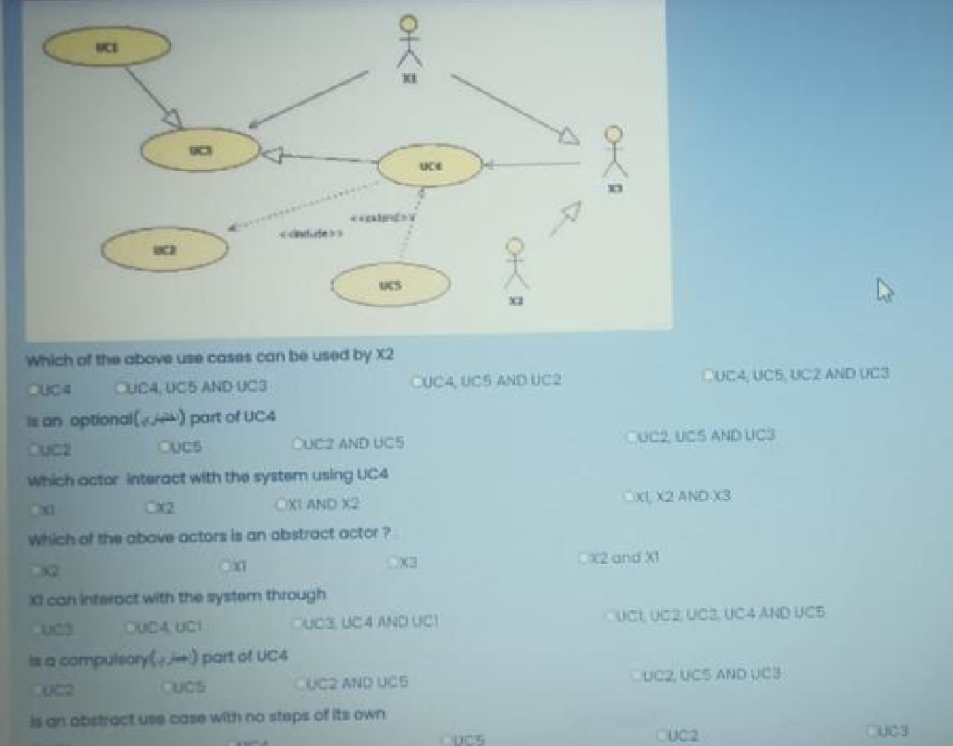

Slide 89
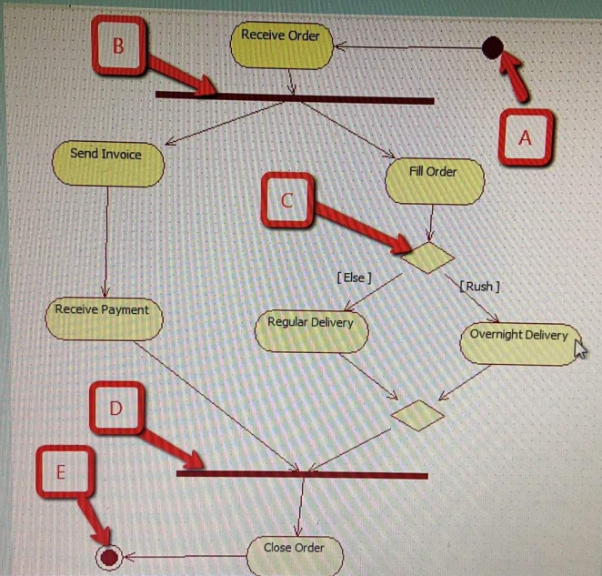
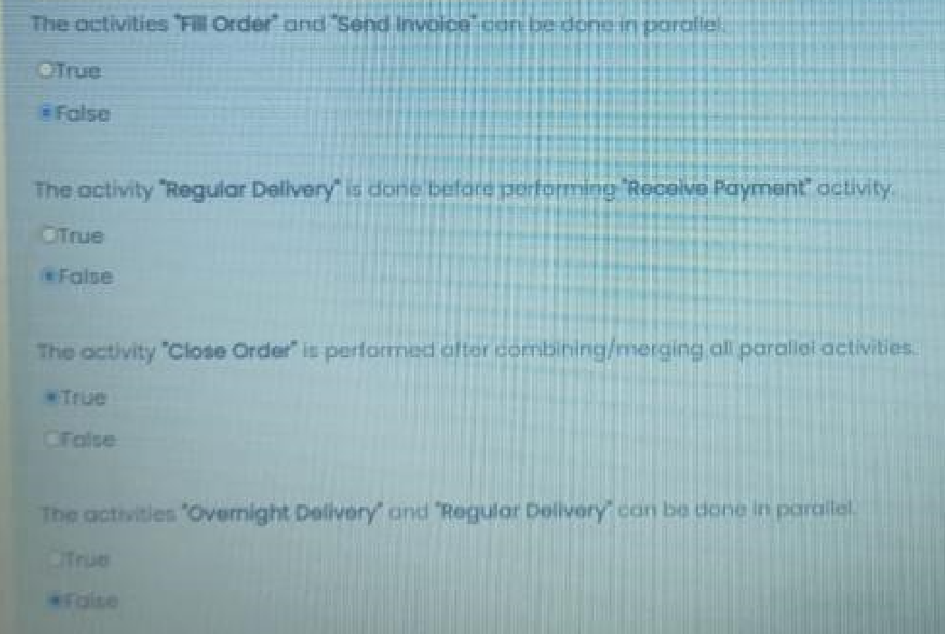

Slide 90
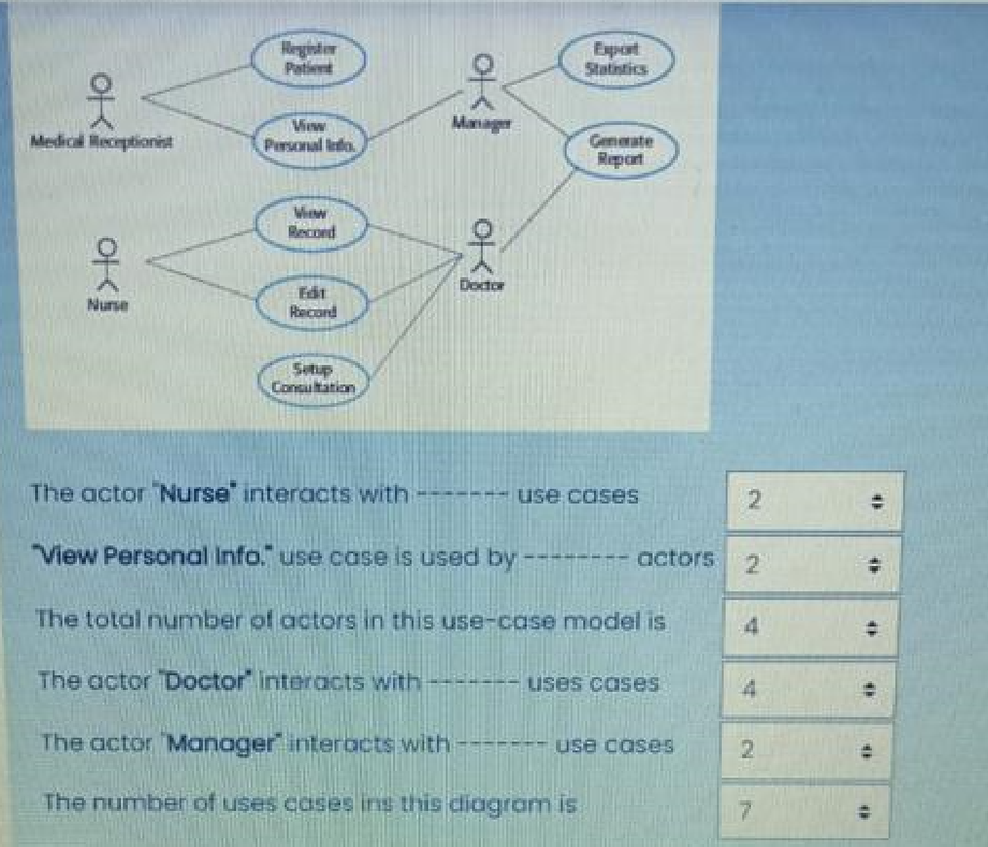

Slide 91
